Slide 1

MIS 300 Spring 2020
Lecture 1
Ali Bazarah

Slide 2
Learning Objectives
1-1 Why are information systems so essential for running and managing a business today?
1-2 What exactly is an information system? How does it work? What are its people, organizational, and technology components?
1-3 How will a four-step method for business problem solving help you solve information system-related problems?
1-4 What information systems skills and knowledge are essential for business careers?
1-5 How will MIS help my career?

Slide 3
How Information Systems are Transforming Business
In 2016, more than 142 million businesses had dot-com addresses registered.
273 million adult Americans online; 183 million purchased online
Internet advertising continues to grow at around 15 percent per year.
New laws require businesses to store more data for longer periods.
Changes in business result in changes in jobs and careers.

Slide 4
What’s New in Management Information Systems?
New technologies
Cloud computing, big data, Internet of Things
Mobile digital platform
Management
Managers use social networks, collaboration
Business intelligence applications accelerate
Virtual meetings proliferate
Organizations
Social business
Telework gains momentum
Co-creation of value, collaboration across firms

Slide 5
Globalization Challenges and Opportunities: A Flattened World
Internet and global communications have greatly reduced economic advantages of developed countries.
Drastic reduction of costs of operating and transacting on global scale
Competition for jobs, markets, resources, ideas
Requires new understandings of skills, markets, opportunities

Slide 6
Business Drivers of Information Systems
Businesses invest in I T to achieve six important business objectives.
Operational excellence
New products, services, and business models
Customer and supplier intimacy
Improved decision making
Competitive advantage
Survival

Slide 7
Operational Excellence
Improved efficiency results in higher profits.
Information systems and technologies help improve efficiency and productivity.
Example: Walmart
Power of combining information systems and best business practices to achieve operational efficiency—and over $473 billion in sales in 2014
Most efficient retail store in world as result of digital links between suppliers and stores

Slide 8
New Products, Services, and Business Models
Information systems and technologies enable firms to create new products, services, and business models.
Business model: how a company produces, delivers, and sells its products and services
Example: Apple
Transformed old model of music distribution with i Tunes
Constant innovations—i Pod, i Phone, i Pad, etc.

Slide 9
Customer and Supplier Intimacy
Customers who are served well become repeat customers who purchase more.
Mandarin Oriental hotel
Uses I T to foster an intimate relationship with its customers, keeping track of preferences, and so on
Close relationships with suppliers result in lower costs.
J C Penney
I T to enhance relationship with supplier in Hong Kong

Slide 10
Improved Decision Making
If managers rely on forecasts, best guesses, and luck, they will misallocate employees, services, and inventory.
Real-time data improves ability of managers to make decisions.
Verizon: Web-based digital dashboard to update managers with real-time data on customer complaints, network performance, and line outages
http://agis.maps.arcgis.com/apps/opsdashboard/index.html#/3c1931b1abac4e05814ffc328bc0c4e3

Slide 11
Competitive Advantage
Often results from achieving previous business objectives
Advantages over competitors:
Charging less for superior products, better performance, and better response to suppliers and customers
Examples: Apple, Walmart, U P S are industry leaders because they know how to use information systems for this purpose

Slide 12
Survival
Businesses may need to invest in information systems out of necessity; simply the cost of doing business.
Keeping up with competitors
Citibank’s introduction of A T M s

Slide 13
What is an Information System? (1 of 2)
Information technology: the hardware and software a business uses to achieve objectives
Information system: interrelated components that collect (or retrieve), process, store, distribute, and manage information to:
Support decision making and control
Help with analysis, visualization, and product creation
Data: streams of raw facts
Information: data shaped into meaningful, useful form

Slide 14
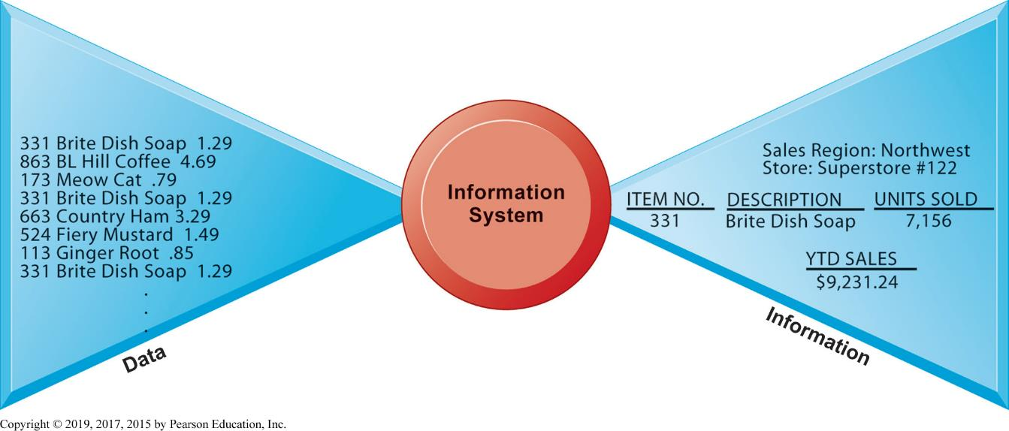
Figure 1.1 Data and Information

Slide 15
What is an Information System? (2 of 2)
Activities in an information system that produce information:
Input: captures or collects raw data from within or outside the organization.
Processing: converts this raw input into a meaningful form
Output: transfers the processed information to the people who will use it
Feedback
Example (Kroger food temperature)
Sharp distinction between computer or computer program versus information system

Slide 16
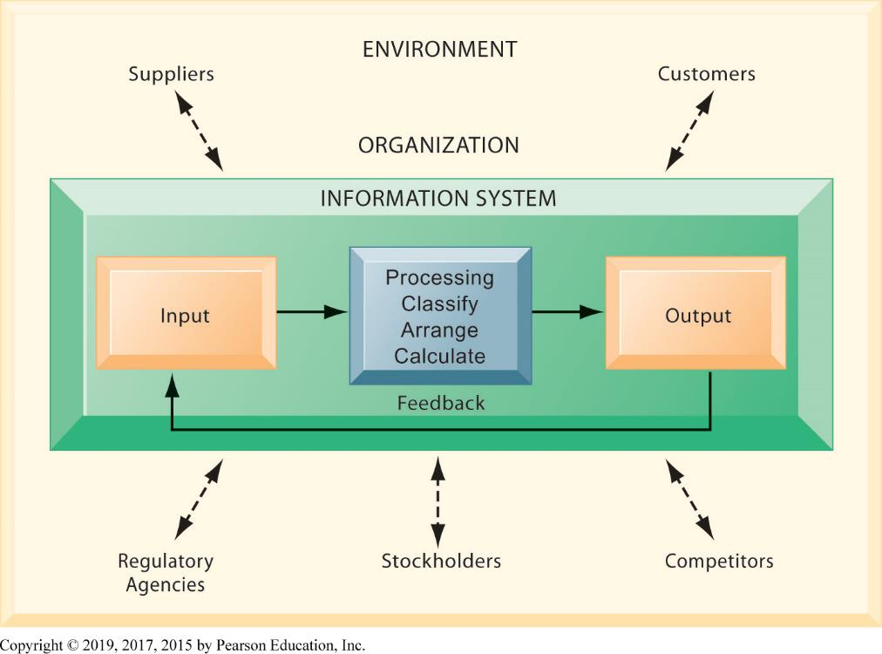
Figure 1.2 Functions of an Information System

Slide 17
The Role of People and Organizations
Information systems literacy
Includes behavioral and technical approach
Computer literacy
Focuses mostly on knowledge of I T
Management information systems (M I S)
Focuses on broader information systems literacy
Issues surrounding development, use, impact of information systems used by managers and employees

Slide 18
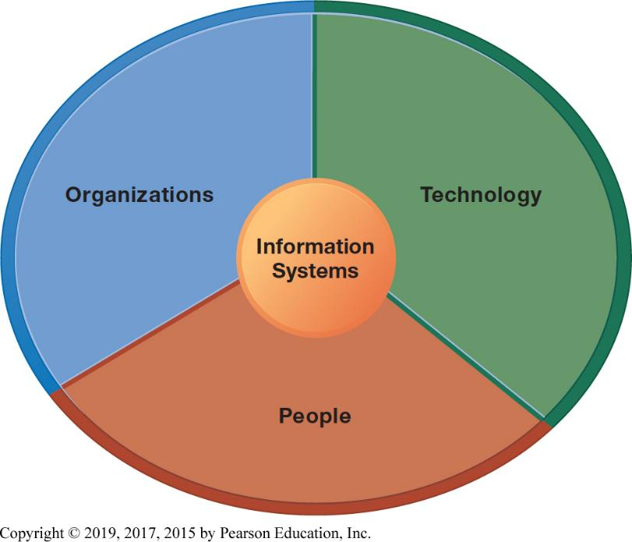
Figure 1.3 Information Systems are More Than Computers

Slide 19
Dimensions of Information Systems (1 of 3)
Organizations
Coordinate work through structured hierarchy and business processes
Business processes: related tasks and behaviors for accomplishing work
Examples: fulfilling an order, hiring an employee
May be informal or include formal rules
Culture embedded in information systems
Example: U P S ’ s concern with placing service to customer first

Slide 20
Dimensions of Information Systems (2 of 3)
People
Information systems require skilled people to build, maintain, and use them.
Employee attitudes affect ability to use systems productively.
Role of managers:
Perceive business challenges
Set organizational strategy
Allocate human and financial resources
Creative work: new products, services

Slide 21
Dimensions of Information Systems (3 of 3)
Technology
I T Infrastructure: Foundation or platform that information systems are built on
Computer hardware
Computer software
Data management technology
Networking and telecommunications technology
Internet and Web, extranets, intranets
Voice, video communications

Slide 22
Interactive Session – Technology: U P S Competes Globally with Information Technology
Class discussion
What are the inputs, processing, and outputs of U P S ’ s package tracking system?
What technologies are used by U P S ? How are these technologies related to U P S ’ s business strategy?
What strategic business objectives do U P S ’ s information systems address?
What would happen if U P S ’ s information systems were not available?
https://www.youtube.com/watch?v=aS97ypMwAgg

Slide 23
The Problem-Solving Approach
Few business problems are simple or straightforward.
Most business problems involve a number of major factors that can fall into three main categories:
Organization
Technology
People

Slide 24
A Model of the Problem-Solving Approach (1 of 7)
Problem solving: four-step process
Problem identification
Solution design
Choice
Implementation

Slide 25
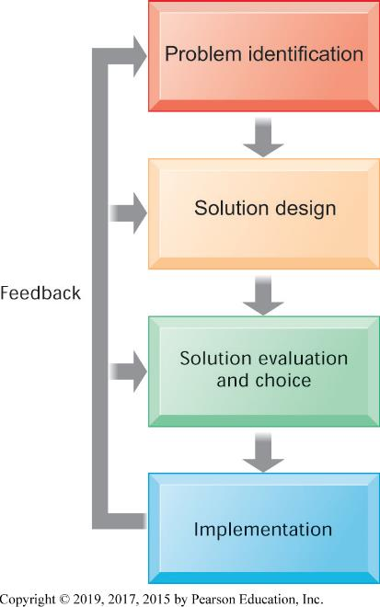
Figure 1.4 Problem Solving is a Continuous Four-Step Process

Slide 26
A Model of the Problem-Solving Approach (2 of 7)
Problem identification includes:
Agreement that problem exists
Definition of problem
Causes of problem
What can be done given resources of firm

Slide 27
A Model of the Problem-Solving Approach (3 of 7)
Typical organizational problems
Outdated business processes
Unsupportive culture and attitudes
Political in-fighting
Turbulent business environment, change
Complexity of task
Inadequate resources

Slide 28
A Model of the Problem-Solving Approach (4 of 7)
Typical technology problems
Insufficient or aging hardware
Outdated software
Inadequate database capacity
Insufficient telecommunications capacity
Incompatibility of old systems with new technology
Rapid technological change

Slide 29
A Model of the Problem-Solving Approach (5 of 7)
Typical people problems
Lack of employee training
Difficulties of evaluating performance
Legal and regulatory compliance
Work environment
Poor or indecisive management
Lack of employee support and participation

Slide 30
A Model of the Problem-Solving Approach (6 of 7)
Solution design
Often many possible solutions (org., people, tech.)
Consider as many as possible to understand range of solutions
Solution Evaluation and Choice
Factors include
Cost
Feasibility given resources and skills
Length of time needed to implement solution

Slide 31
A Model of the Problem-Solving Approach (7 of 7)
Implementation
Building or purchasing solution
Testing solution, employee training
Change management
Measurement of outcomes
Feedback, evaluation of solution
Problem solving is a continuous process, not a single event
Sometimes chosen solution doesn’t work or needs adjustment

Slide 32
Facebook
https://www.youtube.com/watch?v=_r97qdyQtIk&t=332s

Slide 33
The Role of Critical Thinking in Problem Solving (1 of 2)
Without critical thinking, easy to jump to conclusions, misjudge a problem, and waste resources
Critical thinking:
Sustained suspension of judgment with an awareness of multiple perspectives and alternatives
Ability to collect and analyze data that might help understand the nature of the problem; a “data driven” approach

Slide 34
The Role of Critical Thinking in Problem Solving (2 of 2)
Four elements of critical thinking:
Maintaining doubt and suspending judgment
Being aware of different perspectives
Including technology, organization, and people perspectives
Testing alternatives and letting experience guide
Being aware of organizational and personal limitations

Slide 35
The Connections Among Business Objectives, Problems, and Solutions
When firms cannot achieve business objectives these objectives become challenges.
Information systems often present solutions, partially or fully, to these challenges.

Slide 36
How Information Systems Will Affect Business Careers (1 of 9)
Success in today’s job market requires a broad set of skills.
Job candidates must have problem-solving skills as well as technical skills so that they can complete specific tasks.
The service sector will account for 95 percent of the new jobs that are created or open up by 2022.

Slide 37
How Information Systems Will Affect Business Careers (2 of 9)
Accounting:
Accountants increasingly rely on information systems to summarize transactions, create financial records, organize data, and perform financial analysis.
Skills:
Knowledge of databases and networks
Online financial transactions and reporting systems
How systems are used to achieve accounting functions

Slide 38
How Information Systems Will Affect Business Careers (3 of 9)
Finance:
Relationship between information systems and financial management and services is so strong that many advise finance majors to co-major in information systems.
Skills:
Use systems for financial reporting, direct investment activities, implementation of cash management strategies
Plan, organize, implement information systems strategies for the firm

Slide 39
How Information Systems Will Affect Business Careers (4 of 9)
Marketing:
No field has undergone more technology-driven change in the past five years than marketing and advertising.
Skills:
Work with databases for tracking and reporting on customer behavior, product performance, customer feedback, product development
Enterprise systems for product management, sales force management, customer relationship management

Slide 40
How Information Systems Will Affect Business Careers (5 of 9)
Operations management in services and manufacturing:
Production managers, administrative service managers, and operations analysts
Skills:
Hardware and software platforms for operations management
Use database and analytical software for coordinating and optimizing resources required for producing goods and services

Slide 41
How Information Systems Will Affect Business Careers (6 of 9)
Management:
The job of management has been transformed by information systems.
Impossible to manage business today without information systems
Skills:
Use of information systems for each function of job, from desktop productivity tools to applications coordinating the entire enterprise

Slide 42
How Information Systems Will Affect Business Careers (7 of 9)
Information systems:
Fast changing and dynamic profession because information technologies are among most important tools for achieving business firms’ key objectives
Domestic and offshore outsourcing
Skills:
Uses of new and emerging hardware and software to achieve six business objectives
An ability to take a leadership role in the design and implementation of new information systems

Slide 43
How Information Systems Will Affect Business Careers (8 of 9)
Outsourcing and offshoring:
Two types: outsourcing to domestic U.S. firms and outsourcing to low-wage countries such as India, China
Production programming, system maintenance, call centers
Benefits:
Lower cost of building and maintaining systems within U.S.
Increased need for managerial positions

Slide 44
How Information Systems Will Affect Business Careers (9 of 9)
Common requirements for all majors
How I T helps achieve six business objectives
Central role of databases
Business analytics and intelligence systems
Working with specialists and systems designers
Ethical, social, legal environment and issues
Use of I T to meet legal requirements

